Slide 1

HOME SAFETY
IOT-BASED GAS LEAKAGE DETECTION SYSTEM
PRESENTED BY TEAM AJCE
JISHIN BIJUMON
SHARON THOMAS
JOEL JAMES
ROHAN P THOMAS

Slide 2
Contents
01
Introduction
02
Idea of the Project
03
Components Used
04
Implementation & Methodology
05
Circuit Diagram
06
Testing & Results
07
Benefits of the Project
08
Future Scope
09
Conclusion

Slide 3
Introduction
Gas leaks pose serious safety hazards in homes and industries, leading to fire outbreaks and health risks.
This project presents an IoT-based Gas Leakage Detection & Environmental Monitoring System using the ESP8266 microcontroller.
The system integrates an MQ5 gas sensor to detect hazardous gases, a DHT11 sensor to monitor temperature, and visual/audio alerts (LEDs & buzzer) for immediate warning.
All sensor data is stored in Firebase for real-time monitoring and analysis

Slide 4
Idea of the Project
Problem: Gas leaks (LPG, methane) can cause explosions, poisoning, and fires.
Solution:
A low-cost, IoT-enabled system to detect gas leaks instantly.
Visual & audio alerts (Red LED + Buzzer) for immediate warning.
Firebase integration for storing sensor data (gas levels + temperature).
Audio alarms (buzzer).
Cloud storing of Data for analysing.
Temperature monitoring using DHT11
Real-time gas leakage detection
Emergency Alert System
Audio alarm
Cloud data logging

Slide 5
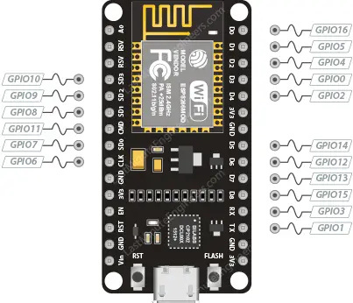
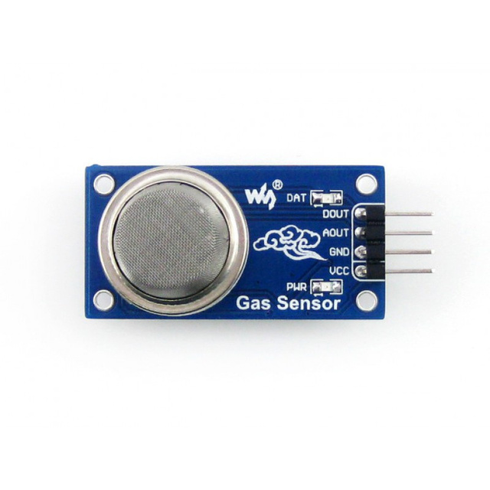
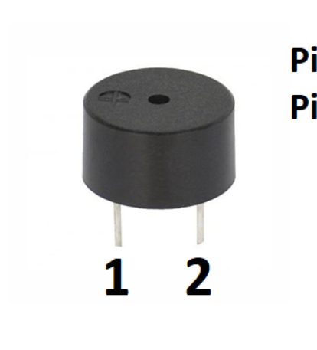
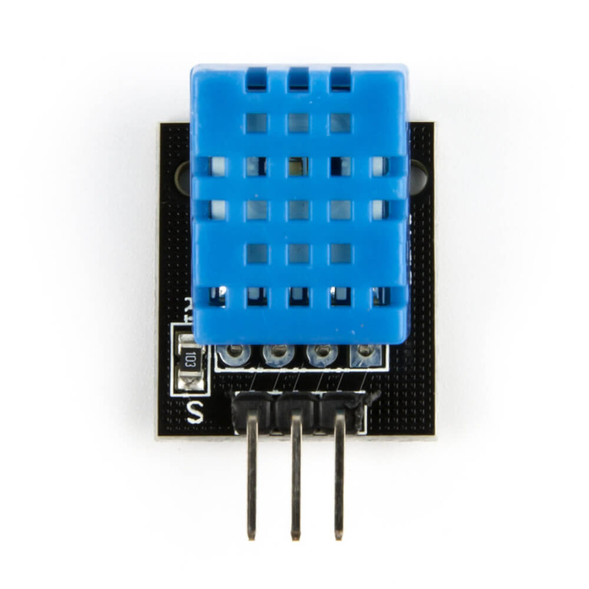


Components Used
ESP 8266 Module
DHT11 Temperature & Humidity Sensor
MQ-5 Sensor
LEDs (Red & White )
Buzzer
Misc. (Wiring, Connections etc.)

Slide 6
Implementation
If White LED is ON then the system is safe .
Purpose:
Detect gas leaks using ESP8266 and MQ5 sensor.
Red LED turns on instantly when gas is detected and then the buzzer after 2 seconds.
Alerts and Buzzer sounds are according to the Gas Leakage .
DHT11 measures temperature/humidity; data is sent to Firebase.

Slide 7
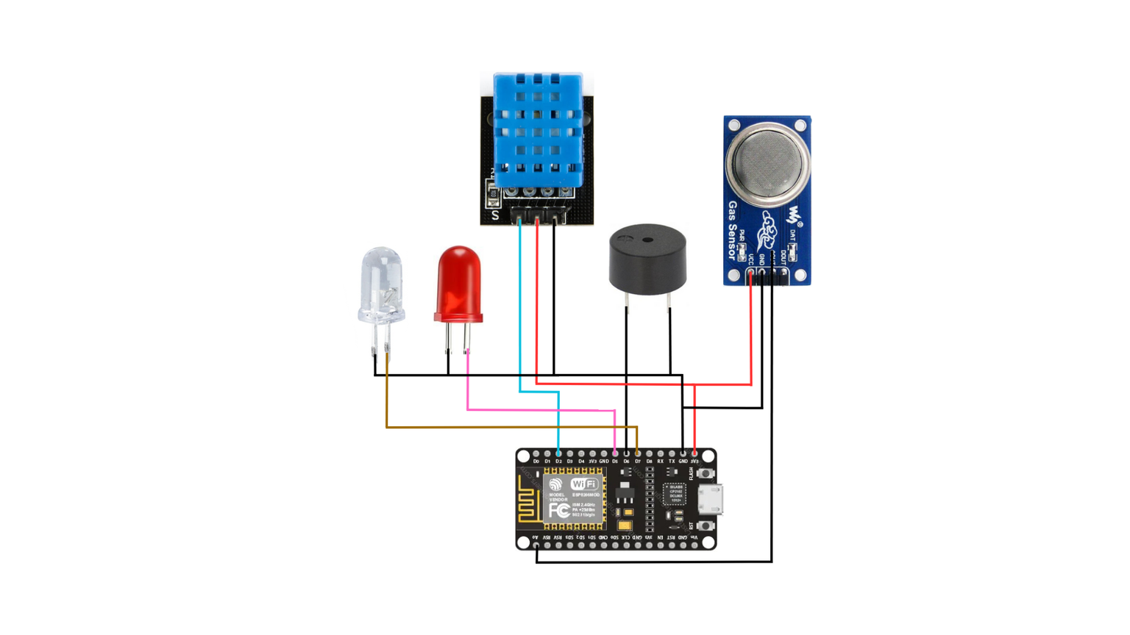
Circuit Diagram

Slide 8
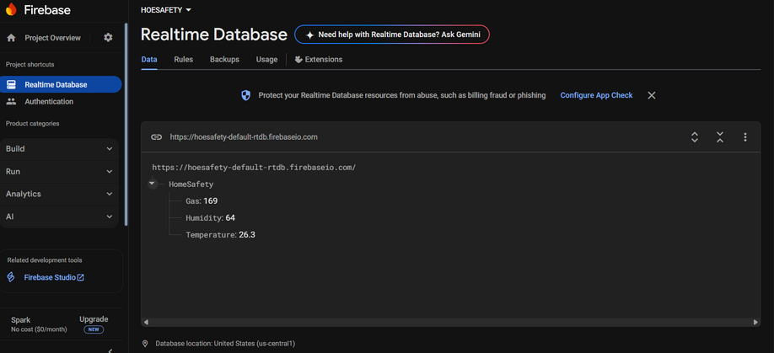
Testing & Results
Normal Air (Safe Condition): White LED ON, no buzzer, Firebase logs temperature.
Gas Leak Detected: Red LED turns ON after 2 seconds, Buzzer beeps faster with higher gas concentration, Firebase updates gas levels in real-time.
Results:
Successfully detected gas leaks.
Firebase stored data accurately.
System responded within 2 seconds of gas detection .
FireBase Interface Showing Real-Time Processing of Gas Leakage

Slide 9
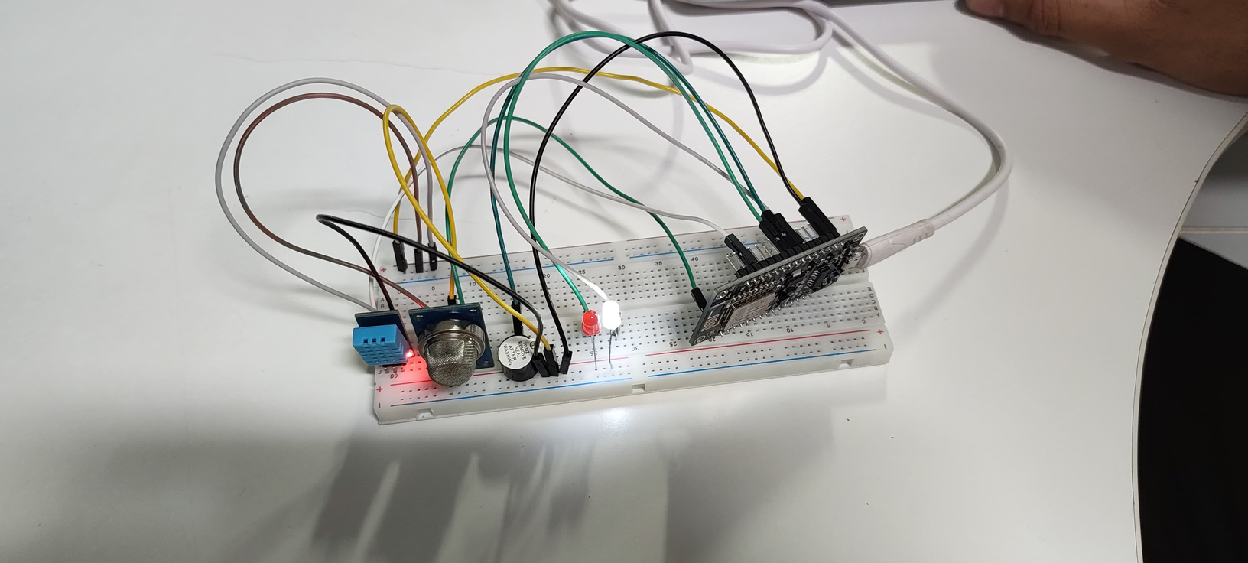
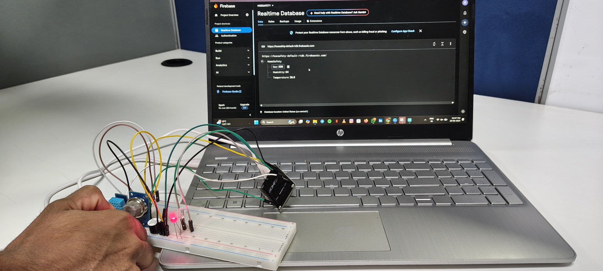
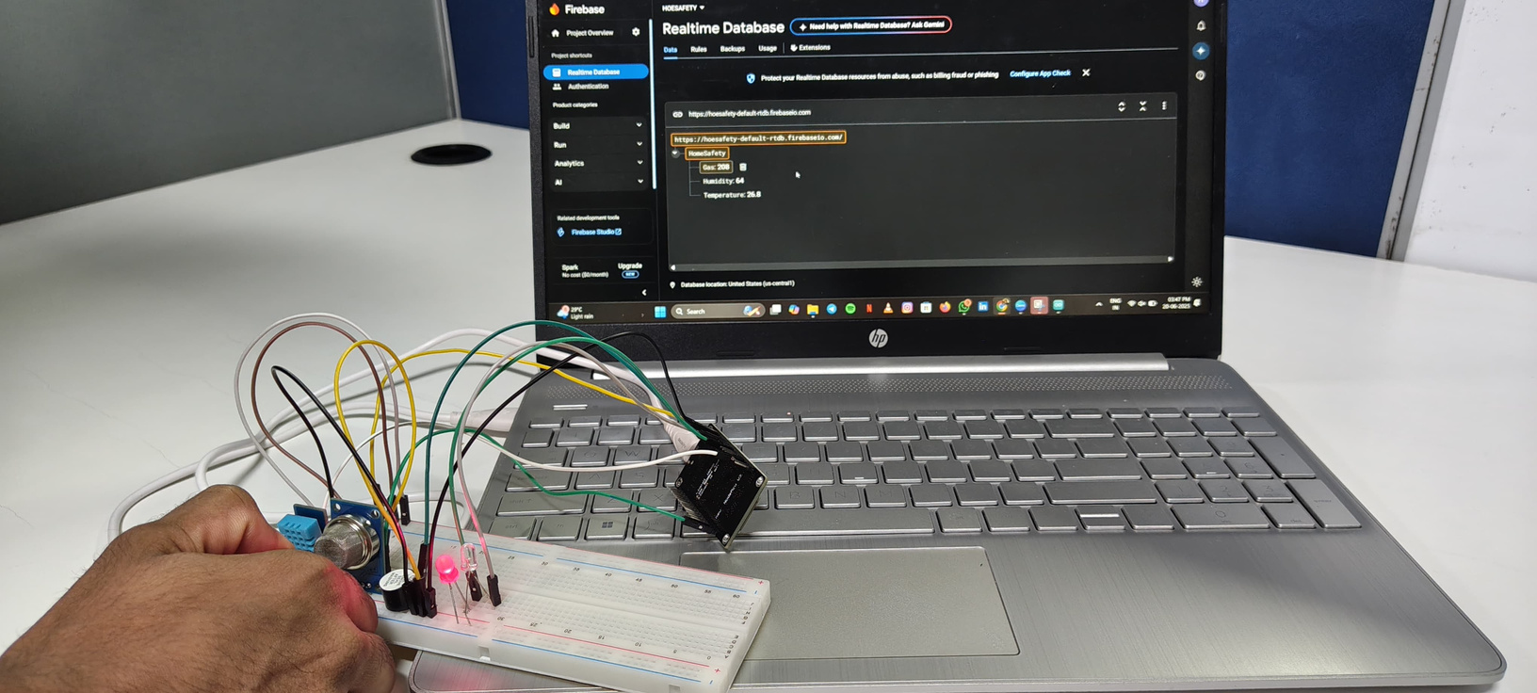

Built Circuit
Below Threshold Value
Exceeding Threshold level
Serial Monitor showing Temperature & Humidity

Slide 10
Benefits Of
The Project
Early Warning System – Quickly detects gas leaks and triggers alarms to prevent accidents.
Real-time Monitoring – Firebase logs sensor data for remote tracking and analysis.
Cost-effective – Uses affordable components like ESP8266 and MQ5 for budget-friendly safety.
Scalable – Can be expanded for industrial use with multiple sensors and automation.

Slide 11
Future Scope
SMS/Email Alerts – Integrate GSM or IFTTT to send emergency notifications.
Smart Home Integration – Connect with Google Home/Alexa for voice alerts.
Portable Battery Design – Make the system wireless for flexible placement.
AI-Based Analysis – Use machine learning to predict gas leaks before they become critical.

Slide 12
Conclusion
This project successfully demonstrates an IoT-based gas leakage detection system that enhances safety through real-time monitoring, instant alerts, and cloud-based data logging, with potential for future upgrades like AI analysis and smart home integration for even smarter safety solutions.

Slide 13
Thank you

